Slide 1
Enthuse Workshop
Foundation of Data Science in Python

Slide 2
Outline
Supervised Learning
Linear regression
Logistic regression
Unsupervised learning
K-means clustering

Slide 3
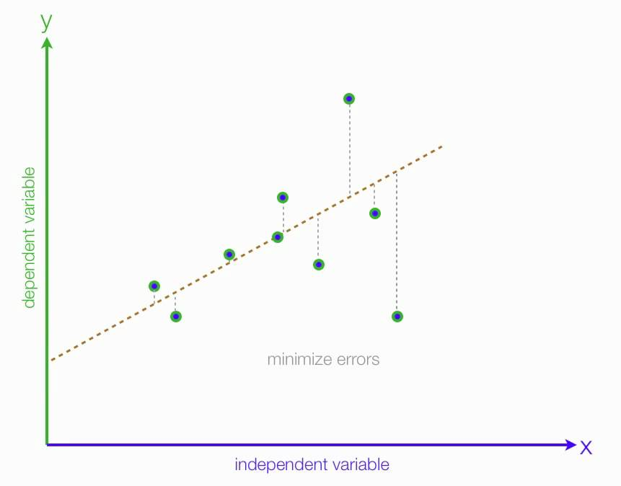
Linear regression
y = ax + b

Slide 4
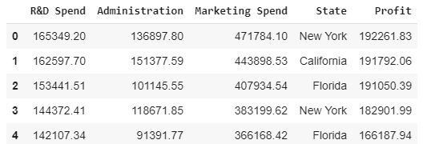
Linear regression: preparing data
the 4th column is text.
we can’t have text in our data if we’re going to run any kind of model on it.
we need to make this data ready for the model: convert it to numbers

Slide 5
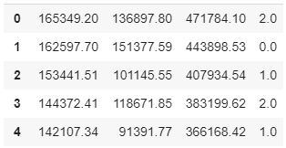
preparing data: label encoder
Each distinct name should be replaced by a number

Slide 6
preparing data: label encoder
Code:
from sklearn.preprocessing import LabelEncoder, OneHotEncoder
labelencoder = LabelEncoder()
X[:, 3] = labelencoder.fit_transform(X[:, 3])

Slide 7
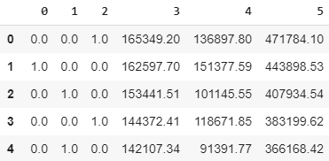
Problem with our encoding
The data is categorical and does not have any relation between different categories
However, our encoding implies a relation: 0 < 1 < 2.
To overcome this problem, we use One Hot Encoder:

Slide 8
Problem with our encoding
Code:
onehotencoder = OneHotEncoder(categorical_features = [3])
X = onehotencoder.fit_transform(X).toarray()

Slide 9
Predicting the profit using linear regression
We need to split the dataset into the training set and test set:
from sklearn.model_selection import train_test_split
X_train, X_test, y_train, y_test = train_test_split(X, y, test_size = 0.2, random_state = 0)

Slide 10
Predicting the profit using linear regression
And then fit a regression model:
from sklearn.linear_model import LinearRegression
regressor = LinearRegression()
regressor.fit(X_train, y_train)

Slide 11
Predicting the profit using linear regression
Test the model:
y_pred = regressor.predict(X_test)

Slide 12
Classification: Logistic Regression

Slide 13



Logistic regression: Use cases
Email spam detection
Tumor classification
Y = {0,1}

Slide 14
Fitting a line with regression
(Yes) 1
(No) 0
Tumor Size
Problems:
Output is not bounded to [0,1]
Output does not give indication of uncertainty

Slide 15
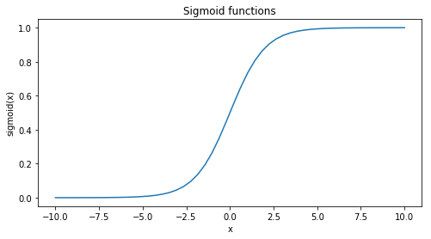

Introducing the sigmoid function
$$σ\left(x\right)= {\left(1+e^{−θ^{T}x}\right)}^{−1}$$

Slide 16
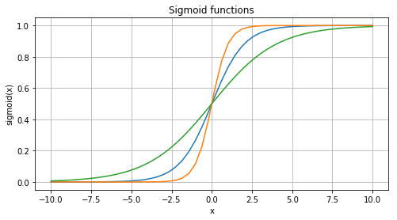
Introducing the sigmoid function
$$σ\left(x\right)= {\left(1+e^{−θ^{T}x}\right)}^{−1}$$

Slide 17
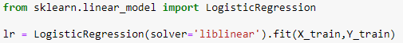
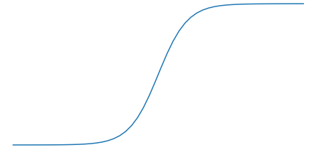
Using logistic regression in sklearn
(Yes) 1
Two key components underneath:
Loss function
Optimizer
(No) 0
Tumor Size

Slide 18
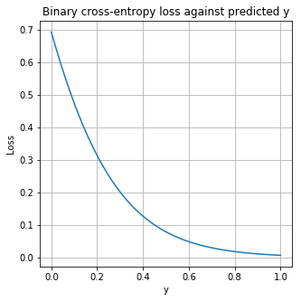
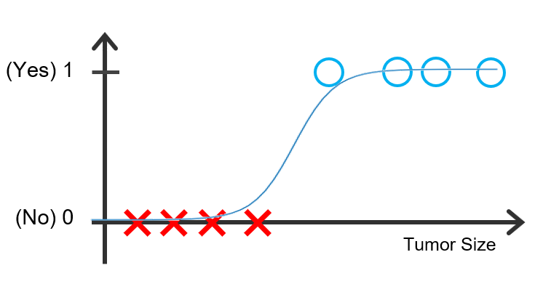
1. Loss function
“binary cross-entropy” helps us to measure performance of the classifier
Ideally, model should predict ‘Yes’ points close to 1 to achieve low loss.

Slide 19
2. Optimization
Newton’s method
Decision boundary
0.5
An optimizer finds the set of parameters that minimizes the loss function

Slide 20
Part 2. Unsupervised learning: K-means clustering

Slide 21
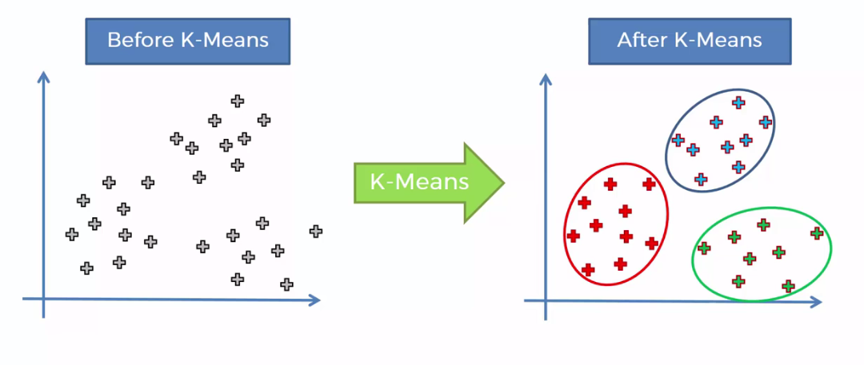
K-means clustering
objective: group similar data points together and discover underlying patterns.
K-means looks for a fixed number (k) of clusters in a dataset

Slide 22
K-means clustering
Initialize and fit:
from sklearn.cluster import KMeans
kmeans = KMeans(n_clusters = 5, init = 'k-means++')
kmeans.fit(features)
Cluster assignments for each data point:
assignments = kmeans.fit_predict(features)
Centeroids:
kmeans.cluster_centers_

Slide 23
Thank you!

